Slide 1

Studio Shodwe
FUTURECART-AI DRIVEN DEMAND PREDICTION
By Shriya R

Slide 2
INTRODUCTION
Retail businesses face challenges in predicting demand due to dynamic market conditions. This project aims to leverage AI to enhance forecasting accuracy, enabling smarter inventory and marketing decisions.

Slide 3
PROBLEMS STATEMENT
In the E-commerce industry, accurately forecasting product demand is crucial for optimizing inventory, minimizing costs, and maximizing sales. However, traditional forecasting approaches often fail to account for dynamic factors such as online customer behavior and marketing performance. This project addresses the challenge of developing a robust demand forecasting model that integrates historical sales data with Google Analytics KPIs, such as Google clicks and Facebook impressions, to predict future product demand effectively

Slide 4
GOALS
1.ACCURATE DEMAND FORECASTING:
2.OPTIMIZED INVENTORY MANAGEMENT:
Build models to predict retail demand using historical data.
Ensure optimal stock levels through precise predictions
3.Enhanced Decision-Making
Enable data-driven strategies for improved retail efficiency.

Slide 5
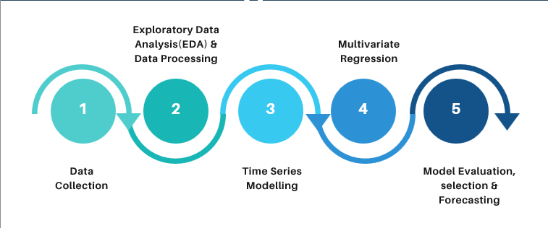
METHODOLOGY

Slide 6
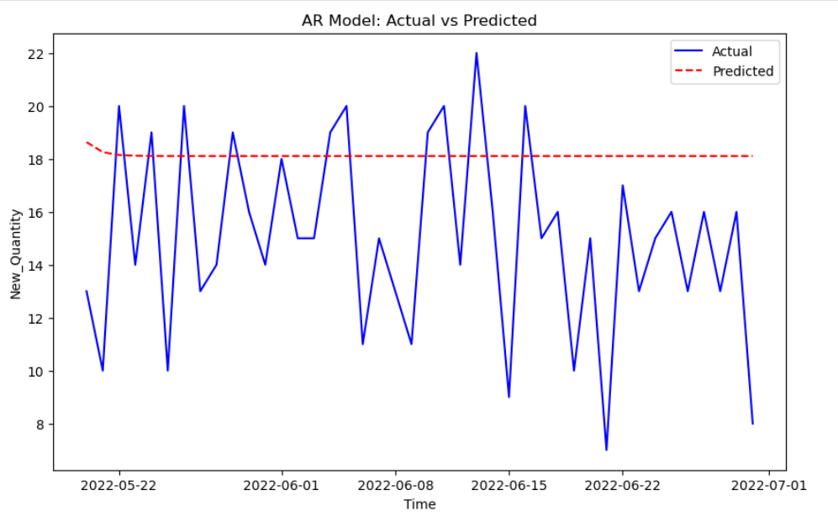
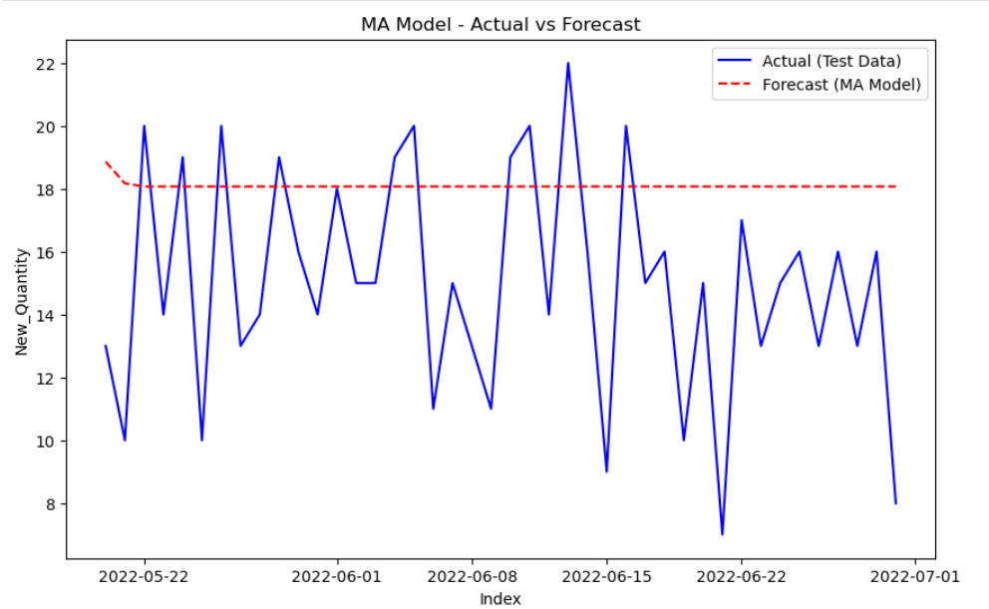
METHODOLOGY
AR MODEL
MA MODEL
AR model uses the past values of the time series to predict future values, capturing temporal dependencies..
MA model models the error term as a linear combination of past forecast errors to make predictions.

Slide 7
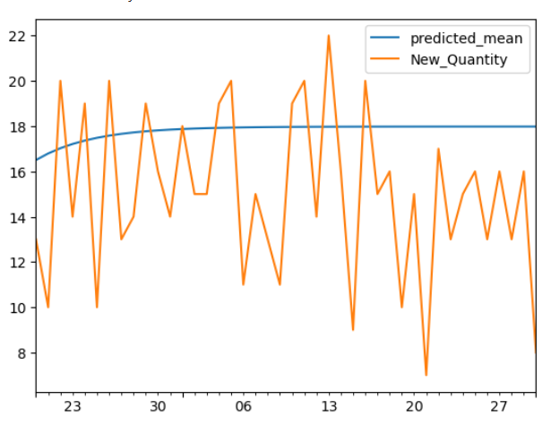
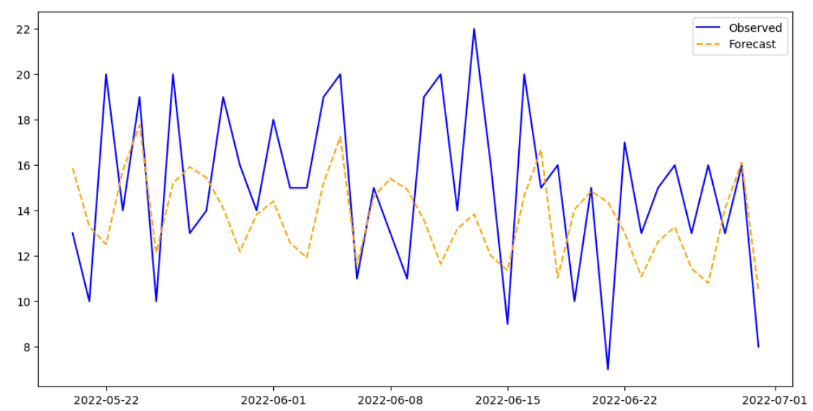
METHODOLOGY
ARIMA MODEL
SARIMA MODEL
ARIMA combines AR and MA models with differencing to model non-stationary time series data.
SARIMA extends ARIMA by including seasonal components to capture patterns in seasonal time series data.

Slide 8
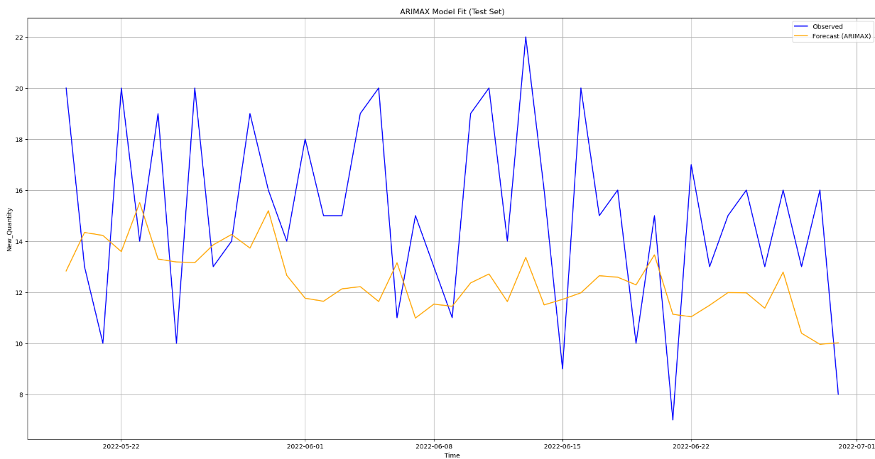
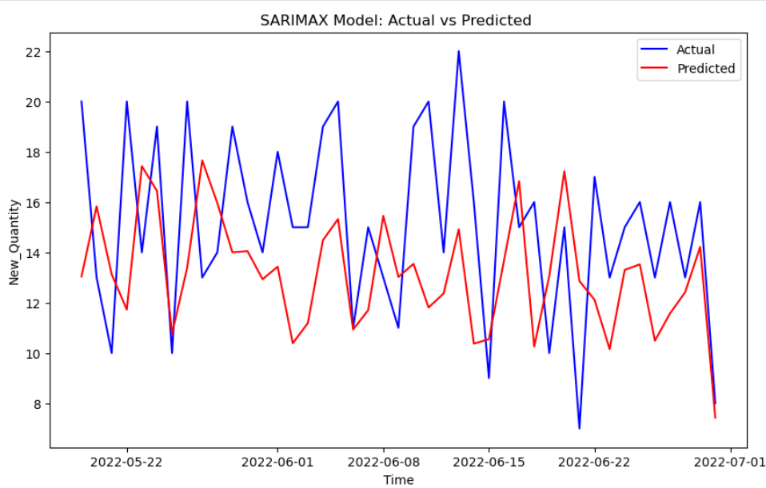
METHODOLOGY
ARIMAX MODEL
SARIMAX MODEL
ARIMAX incorporates external variables alongside the time series data to enhance forecasting accuracy.
SARIMAX combines seasonal patterns and external variables to improve predictions for seasonal time series data.

Slide 9
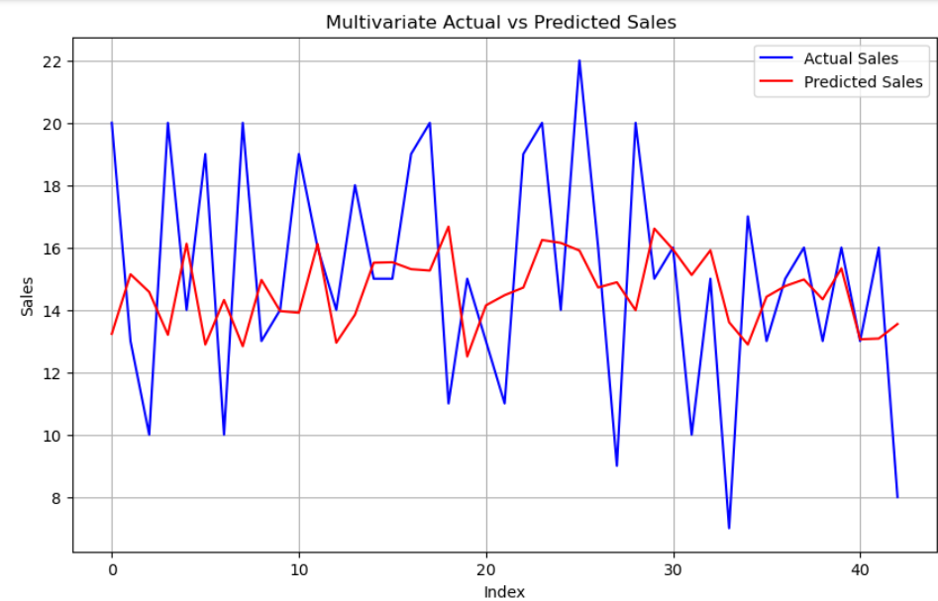
METHODOLOGY
MULTIVARIATE REGRESSION MODEL
Multivariate regression uses multiple predictor variables to forecast the target variable, capturing complex relationships in the data.

Slide 10
MODEL EVALUATION
MODEL | MAE | RMSE | MAPE | TUNED_MAE | TUNED_RMSE | TUNED_MAPE
AR | 3.952626 | 4.783002 | 33.605156 | 3.931377 | 4.848877 | 26.665430
MA | 3.938863 | 4.764123 | 33.467269 | 3.805289 | 4.625463 | 32.363548
ARIMA | 3.807693 | 4.568685 | 32.168950 | 2.932875 | 3.663323 | 21.922006
SARIMA | 3.187208 | 3.817396 | 22.114717 | 3.060982 | 3.750384 | 21.529867
ARIMAX | 3.825958 | 4.490265 | 24.563292 | 3.773958 | 4.420673 | 24.347771
SARIMAX | 4.027269 | 4.711011 | 26.110511 | 3.617950 | 4.182050 | 23.587711
MULTIVARIATE REGRESSION | 3.157348 | 3.880215 | 22.899871 | 3.248266 | 3.958841 | 25.533284

Slide 11
Reasons for chosing SARIMAX Model for forecasting
Handles Exogenous Variables: Includes external factors (e.g., promotions, holidays) to improve forecast accuracy.
Seasonal and Non-Seasonal Modeling: Captures both seasonal and trend components, offering flexibility in modeling.
Improved Forecasting: Provides more accurate predictions by accounting for external influences and seasonality.
Reduced Residuals: Produces residuals with no patterns, indicating good model fit.
Versatile for Complex Data: Effective for data with multiple seasonalities or complex trends, ensuring reliable forecasts

Slide 12
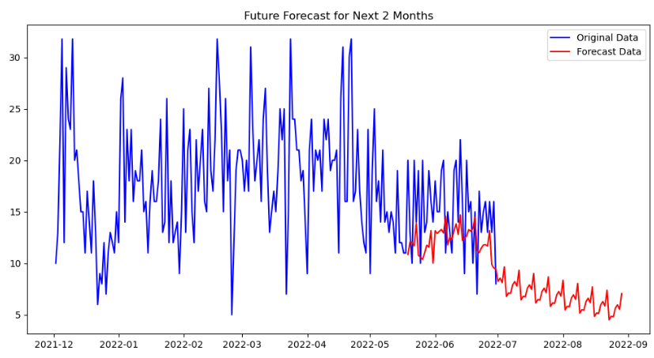
FUTURE FORECAST-MONTHLY BASIS

Slide 13
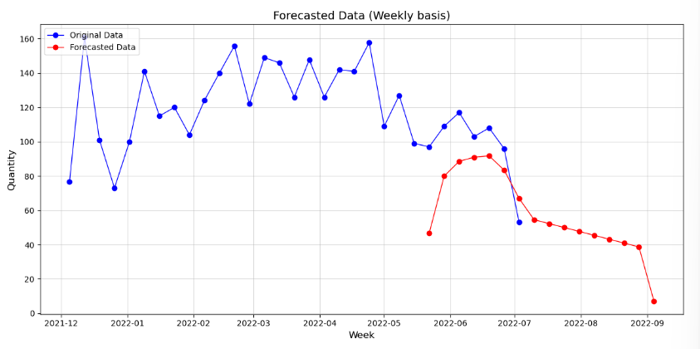
FUTURE FORECAST-WEEKLY BASIS

Slide 14
CONCLUSION
Improved Inventory Management: Predicts future sales trends, ensuring the right amount of inventory is stocked, reducing missed sales opportunities.
Reduced Stockouts: Minimizes out-of-stock situations, leading to higher customer satisfaction and an improved shopping experience.
Optimized Ordering Process: Informs decisions on order timing and quantities, preventing overstocking and reducing carrying costs.
Enhanced Supplier Relationships: Enables effective communication with suppliers, ensuring timely restocking and better negotiation terms.

Slide 15
THANK YOU
By Shriya R

